Slide 1

Automating financial processes *using Machine Learning

Slide 2





About me
Senior Software Developer @ Endava
Cluj-Napoca, Romania
Alexandru.Mortan@endava.com
@AlexandruMortan

Slide 3
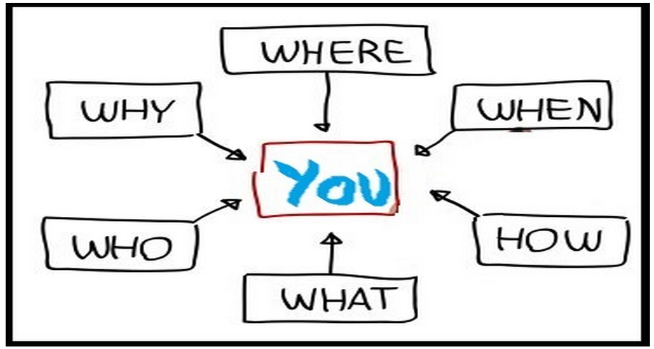
Context/Problem

Slide 4




Slide 5

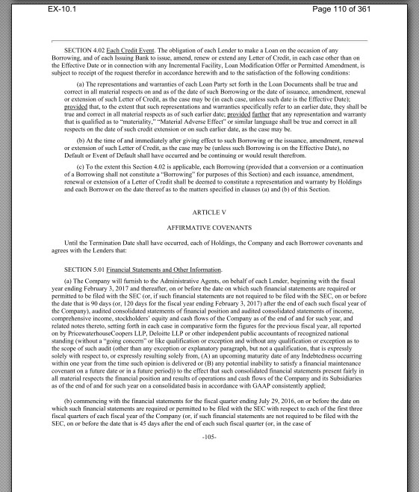
The Company shall deliver as soon as available, but in any event within 90 day after the end of each fiscal year, a copy of the audited consolidated financial statements.
"A clause in a contract drawn up by deed."
- Google Dictionary-

Slide 6

Covenant Monitoring Process

Slide 7

Scope?!

Slide 8

Ease the work of the front office employee

Slide 9


Slide 10


Roadmap
TESSERACT

Slide 11

Roadmap
TESSERACT

Slide 12
Roadmap
TESSERACT

Slide 13


Slide 14


Slide 15
Roadmap
FDSFS
OCR Pipeline
OCR REST
TESSERACT
TESSERACT
TESSERACT
RABBIT MQ

Slide 16
Roadmap
FDSFS
OCR Pipeline
OCR REST
TESSERACT
TESSERACT
TESSERACT
RABBIT MQ

Slide 17
Roadmap
FDSFS
OCR Pipeline
OCR REST
TESSERACT
TESSERACT
TESSERACT
RABBIT MQ

Slide 18
Roadmap
FDSFS
OCR Pipeline
OCR REST
TESSERACT
TESSERACT
TESSERACT
RABBIT MQ

Slide 19
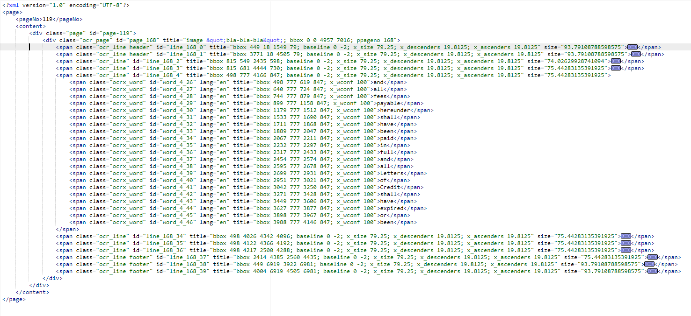
HOCR

Slide 20
start X
start Y
end X
end Y
word confidence
"bbox 2162 1140 2329 1188; x_wconf 100"
(2162, 1140)
(2329, 1188)

Slide 21
Roadmap
Semantic Analysis
OCR Pipeline
HOCR Analyzer
Text Classification

Slide 22
Roadmap
Semantic Analysis
OCR Pipeline
HOCR Analyzer
Text Classification

Slide 23
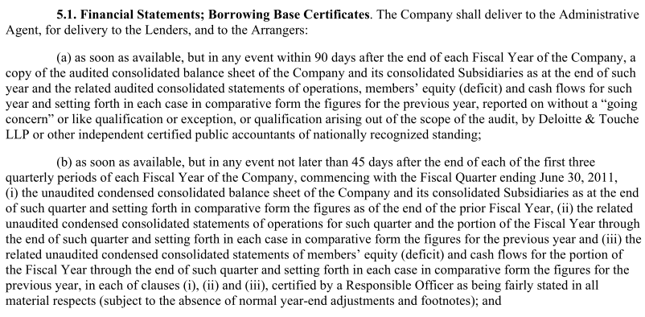
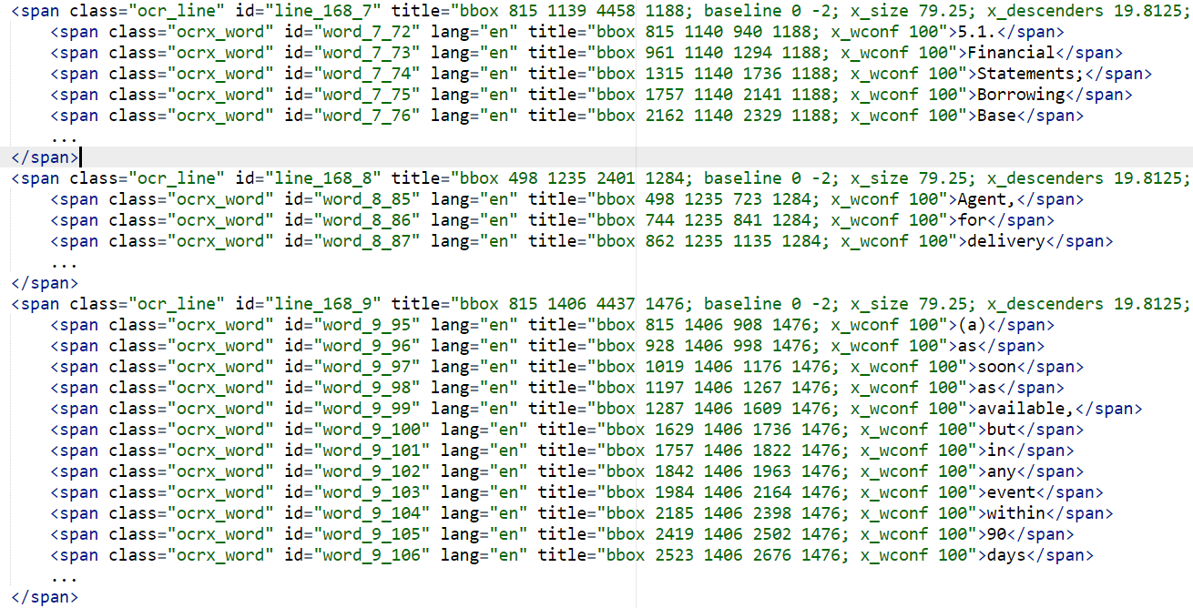

Slide 24
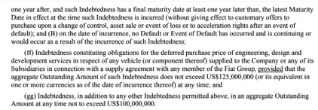
Paragraph reconstruction
compute average line height

Slide 25
Paragraph reconstruction
compute average line height
compute average word spacing

Slide 26
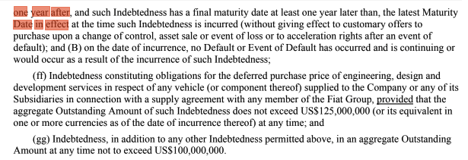
Paragraph reconstruction
compute average line height
compute average word spacing
find neighbors

Slide 27
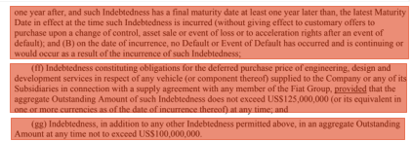
Paragraph reconstruction
compute average line height
compute average word spacing
find neighbors
construct paragraphs

Slide 28
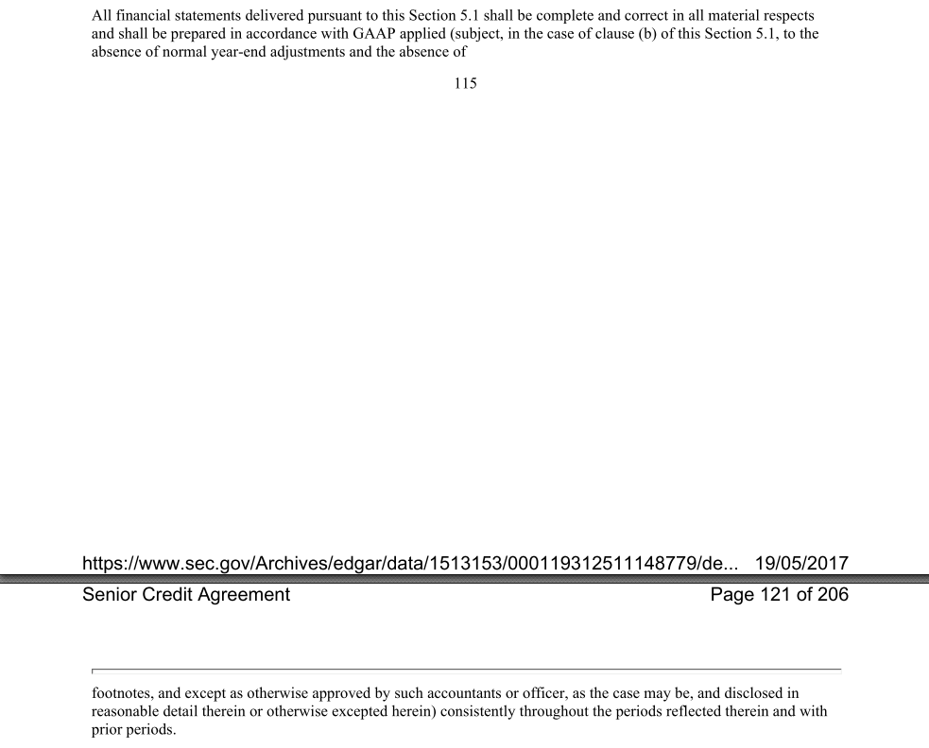
Multiple Pages

Slide 29
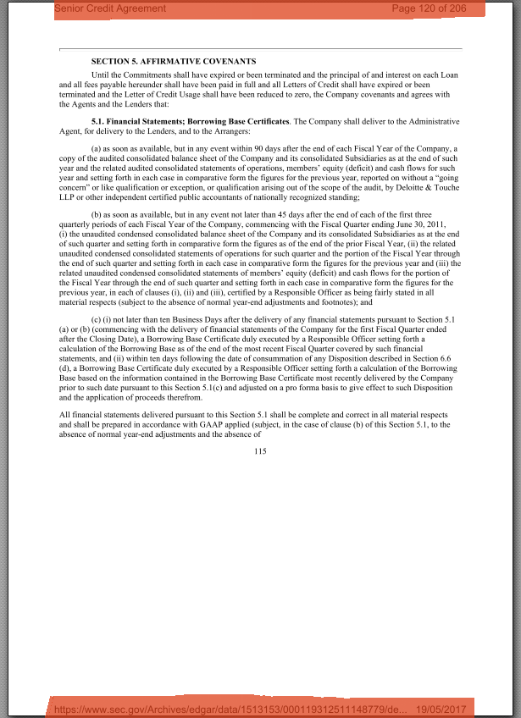
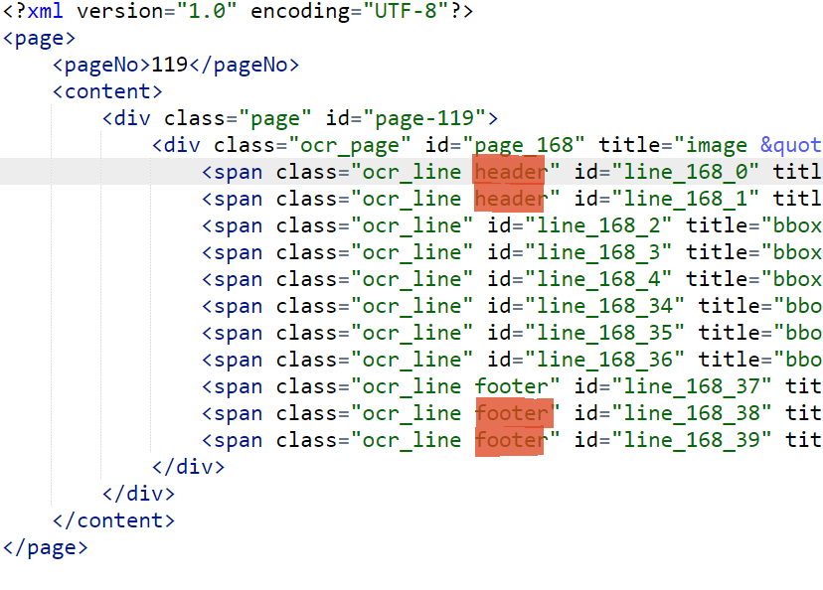

Slide 30
Header/Footer Classifier
HOCR Line
Feature extraction
Supervised learning
Prediction
[bbox, distance_page, ...]
Classifier
Header/Footer/Body

Slide 31
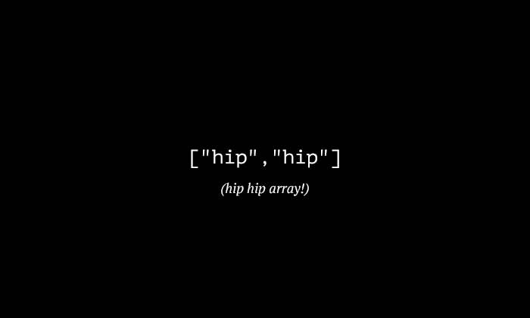

Slide 32
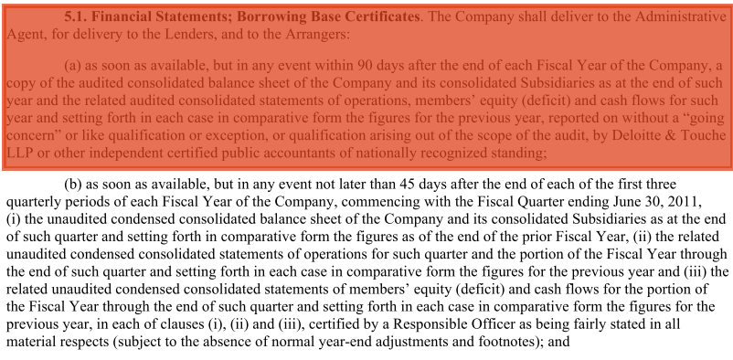
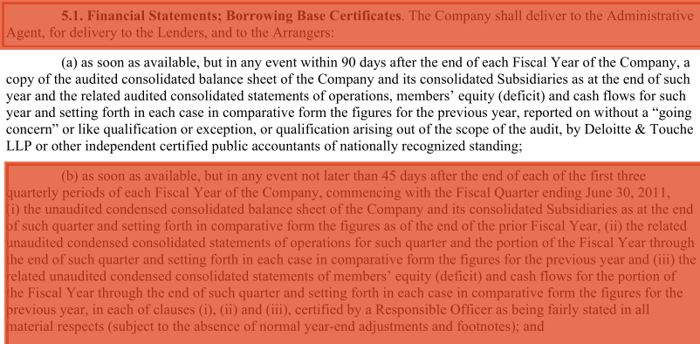
Multiple Covenants

Slide 33
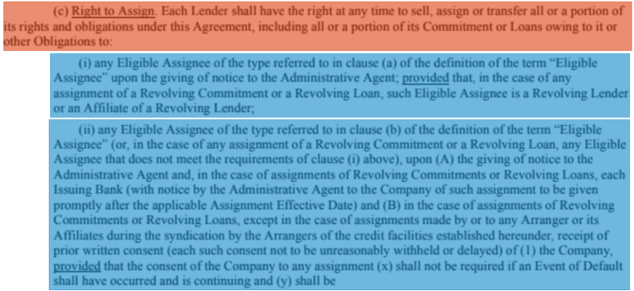
Clustering Paragraphs

Slide 34
Combining Paragraphs
[(c)(i), (c)(ii)]

Slide 35
Roadmap
Semantic Analysis
OCR Pipeline
HOCR Analyzer
Text Classification

Slide 36

Classes
Paragraph
OTHER
FS
LR
DSC
IC
GC

Slide 37
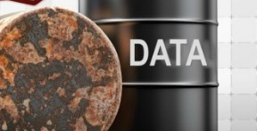

Slide 38
'Leverage Ratio means the ratio of the Consolidated Total Net Borrowings to the Consolidated EBITDA. '
Count Vectorizer
Token | ID
leverage | 0
ratio | 1
word | 2
[1, 2, 0 ….]
TF-IDF Vectorizer
[0.0953, 0.0543, 0.0069]

Slide 39
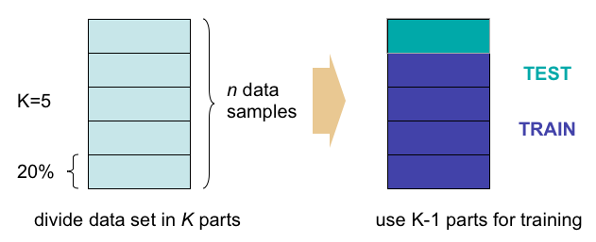
Cross-validation
https://prateekvjoshi.files.wordpress.com/2013/06/cross-validation.png

Slide 40
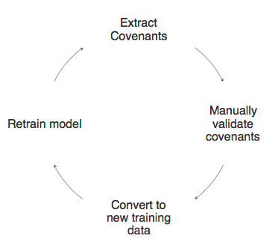
Retraining

Slide 41

Garbage in, Garbage out
Perfect model

Slide 42


Slide 43
Roadmap
Semantic Extraction
OCR Pipeline
Semantic Analysis
Value Extraction
Stanford NLP

Slide 44
party
gracePeriod
The Company shall deliver as soon as available, but in any event within 90 day after the end of each fiscal year, a copy of the audited consolidated financial statements.
frequency
financialType
{"name": "financial_statement", "gracePeriod": 90, "frequency": "annually", "party": "borrower", "financialType": "audited consolidated"}

Slide 45
Roadmap
Semantic Extraction
OCR Pipeline
Semantic Analysis
Value Extraction
Stanford NLP

Slide 46
Part-of-speech tagging

Slide 47
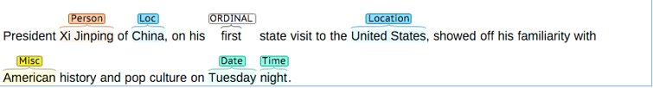
Named Entity Recognition

Slide 48
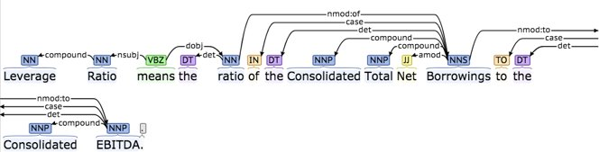
Dependencies

Slide 49
Roadmap
Semantic Extraction
OCR Pipeline
Semantic Analysis
Value Extraction
Stanford NLP

Slide 50
Ontology
<ruleml:imp> <ruleml:_body> <swrlx:classAtom> <owlx:Class owlx:name="Borrower /> <ruleml:var>party</ruleml:var> </swrlx:classAtom> <swrlx:individualPropertyAtom swrlx:property="delivers"> <ruleml:var>action</ruleml:var> </swrlx:individualPropertyAtom> <owlx:Class owlx:name="Document/> <ruleml:var>deliverable</ruleml:var> </swrlx:classAtom>
<swrlx:datavaluedPropertyAtom swrlx:property="gracePeriod">
<ruleml:var>gracePeriod</ruleml:var>
</swrlx:datavaluedPropertyAtom> </ruleml:_body> <ruleml:_head> </ruleml:imp>
Person(?p) ^ hasAge(?p,?age) ^ greaterThan(?age,17) → Adult(?p)

Slide 51
Algorithm
Ontology
NLP Result
Get ontology
Rules
Get NLP result
Match rules

Slide 52
NLP Result
Ontology
<ruleml:imp> <ruleml:_body> <swrlx:classAtom> <owlx:Class owlx:name="Borrower /> <ruleml:var>party</ruleml:var> </swrlx:classAtom> <swrlx:individualPropertyAtom swrlx:property="delivers"> <ruleml:var>action</ruleml:var> </swrlx:individualPropertyAtom> <owlx:Class owlx:name="Document/> <ruleml:var>deliverable</ruleml:var> </swrlx:classAtom>
<swrlx:datavaluedPropertyAtom swrlx:property="gracePeriod">
<ruleml:var>gracePeriod</ruleml:var>
</swrlx:datavaluedPropertyAtom> </ruleml:_body> <ruleml:_head> </ruleml:imp>
shall deliver
company
financial statements
90

Slide 53
Algorithm
Ontology
NLP Result
Get ontology
Rules
Get NLP result
Match rules
Apply custom logic
Custom logic
Semantic-extraction

Slide 54
Roadmap
OCR Pipeline
Semantic Analysis
Semantic Extraction
MarkLogic

Slide 55
Roadmap
OCR Pipeline
Semantic Analysis
Semantic Extraction
MarkLogic

Slide 56

MarkLogic
NoSQL database
Custom modules
Authorization/Authentication

Slide 57
Roadmap
MarkLogic
Web Application

Slide 58
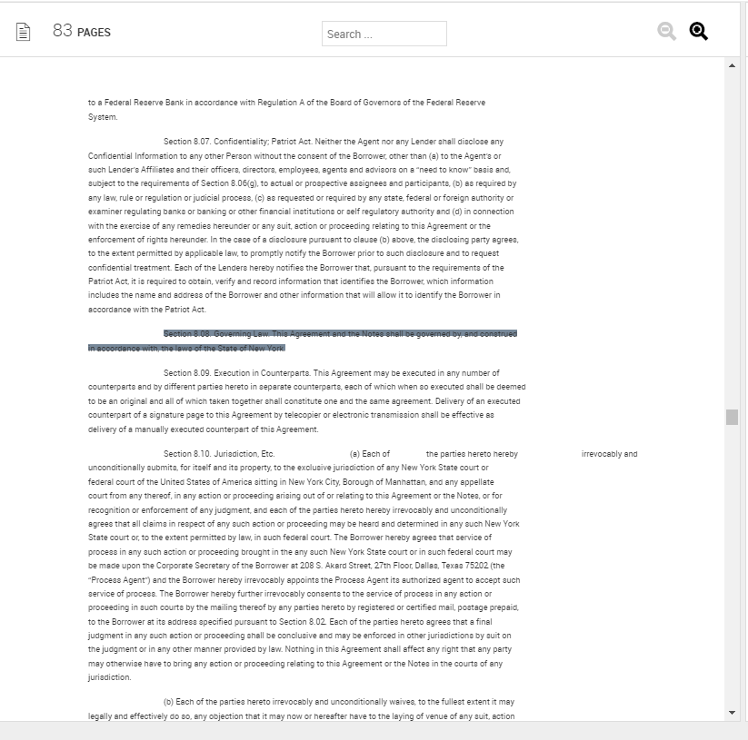
Web Application
Highlight covenants
Suggest functionality
Raw document view

Slide 59

Huge DOM ?!

Slide 60
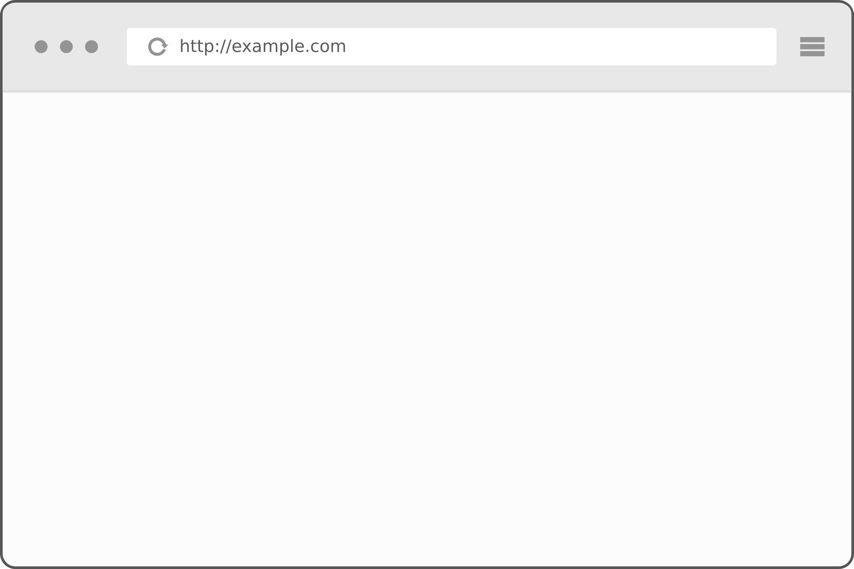
Solution
DOM
<>
Attach/Detach on scroll
Memory
0
1
2
3

Slide 61

How about Deployment?!

Slide 62
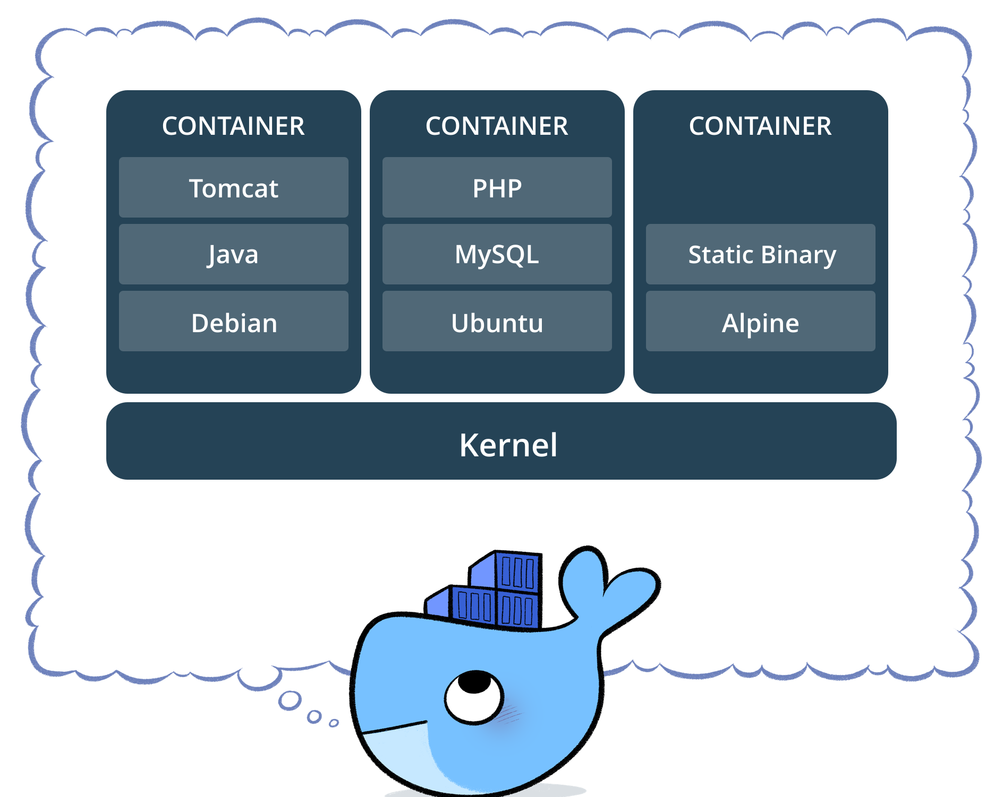
Why Docker?

Slide 63

Docker-Compose
Links
Volumes
Scalability (OCR Worker)
docker-compose scale --ocr-worker=5

Slide 64
Future improvements
Comply with production security aspects (in progress)
Deep learning for table and paragraph detection (in progress)
Aspect term extraction using CRF model for semantic extraction (in progress)
Different UX improvements (ex: highlight based on confidence)
Switch to Kubernetes

Slide 65

Q&A

Slide 66


Slide 67


